Slide 1
Digital Portfolio
STUDENT NAME : SANJOTHIKA SARAVANAN
REGISTER NO AND NMID : E7D33E9F7FAD178906C41EB03A461880
DEPARTMENT : BCA-BACHELOR OF COMPUTER APPLICATION
COLLEGE : VALLIAMMAI WOMEN’S COLLEGE OF ARTS AND SCIENCE/ ANNAMALAI UNIVERSITY

Slide 2

PROJECT TITLE CREATIVE STUDENT PORTFOLIO USING FWD

Slide 3

AGENDA
Problem Statement
Project Overview
End Users
Tools and Technologies
Portfolio design and Layout
Features and Functionality
Results and Screenshots
Let’s Connect

Slide 4
PROBLEM STATEMENT THE NEED FOR A PORTFOLIO * “A personal portfolio showcasing projects and skills.” * To create a central, professional online presence to showcase my skills and project work to potential employers and collaborators.

Slide 5
PROJECT OVERVIEW PROJECT GOALS * A web-based application for managing student records. * Wrote all the HTML, CSS, and JavaScript to build a fast, interactive experience.

Slide 6

WHO ARE THE END USERS? TARGET AUDIENCE ~ Potential employers ~ Peers and mentors ~ Industry professionals ~ Students

Slide 7






TOOLS AND TECHNIQUES TECHNOLOGIES USED HTML Front-end framework (React) CSS Design tools (Figma) JAVA SCRIPT Version control (GitHub)

Slide 8
PORTFOLIO DESIGN AND LAYOUT
DESIGN JOURNEY
~ Research and planning ~ Wireframing and prototyping ~ Design and development ~ Testing and iteration
8

Slide 9
FEATURES AND FUNCTIONALITY KEY FEATURES ~ Digitized and streamlined the process of tracking student information, replacing manual methods. ~ Ensured a responsive layout for mobile and desktop. ~ Created a central, professional online presence to build a fast, interactive experience.

Slide 10
RESULTS AND SCREENSHOTS * A web-based application for a Creative Portfolio has been created using FWD. * Detailed Screenshots of the portfolio were attached in upcoming slide.

Slide 11
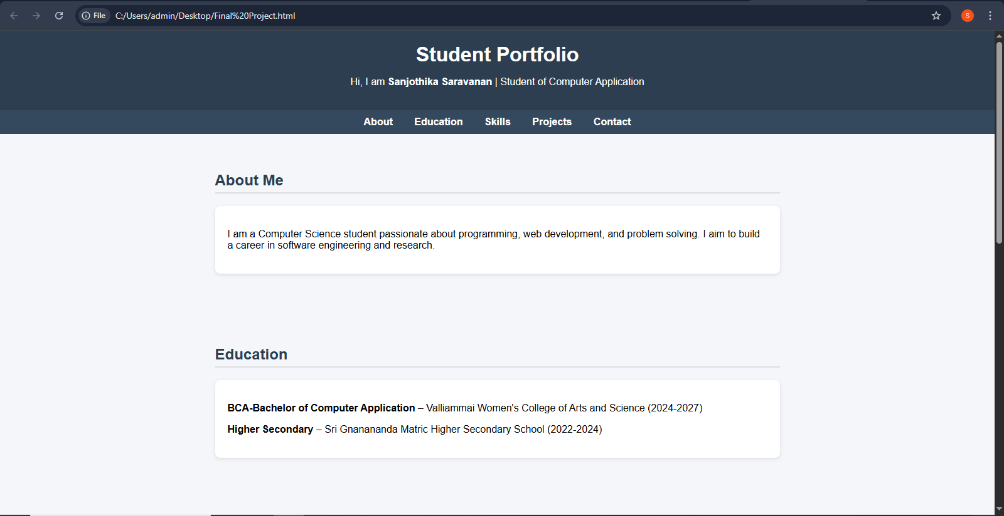

Slide 12
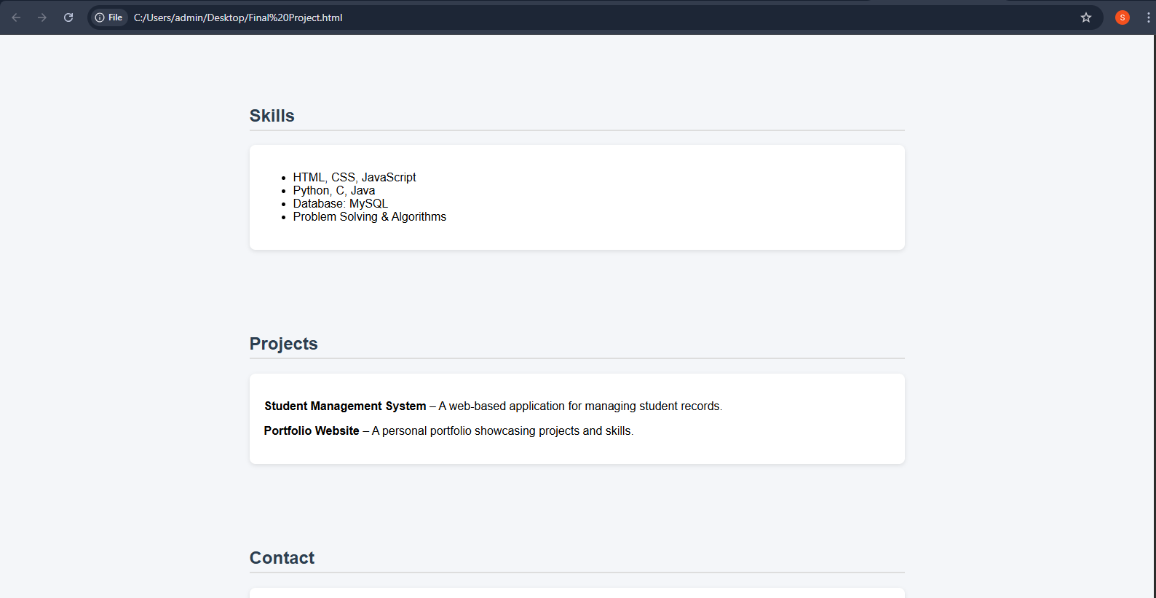

Slide 13
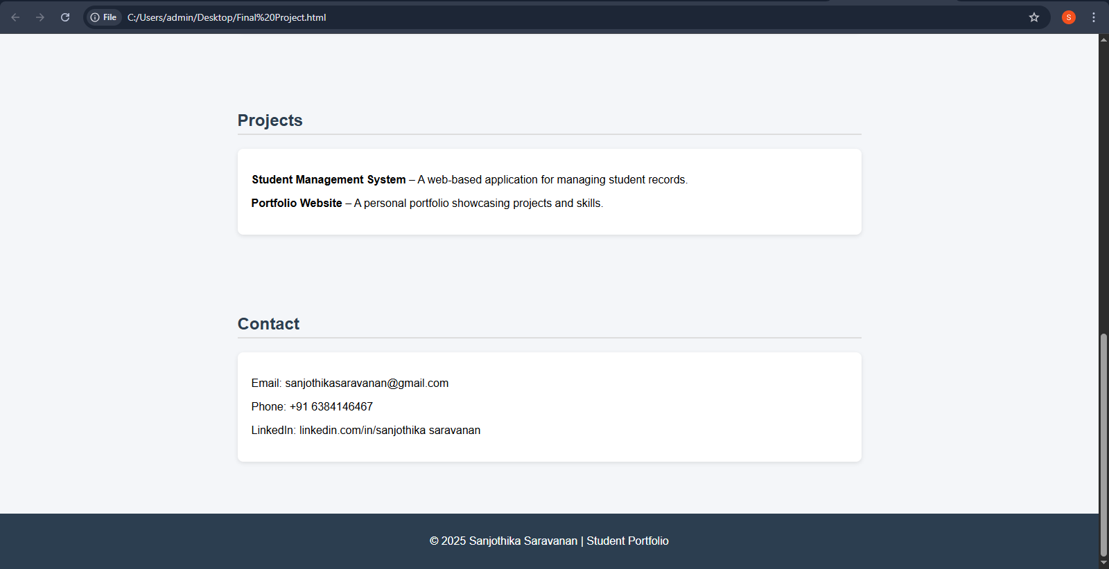

Slide 14
LET’S CONNECT I'm always open to new challenges and collaborations. Contact me through, Email : sanjothikasaravanan@gmail.com Phone : +91 6384146467 LinkedIn : linkedin.com/in/sanjothikasaravanan GitHub : https://github.com/sanjosaravanan .
14

